Slide 1
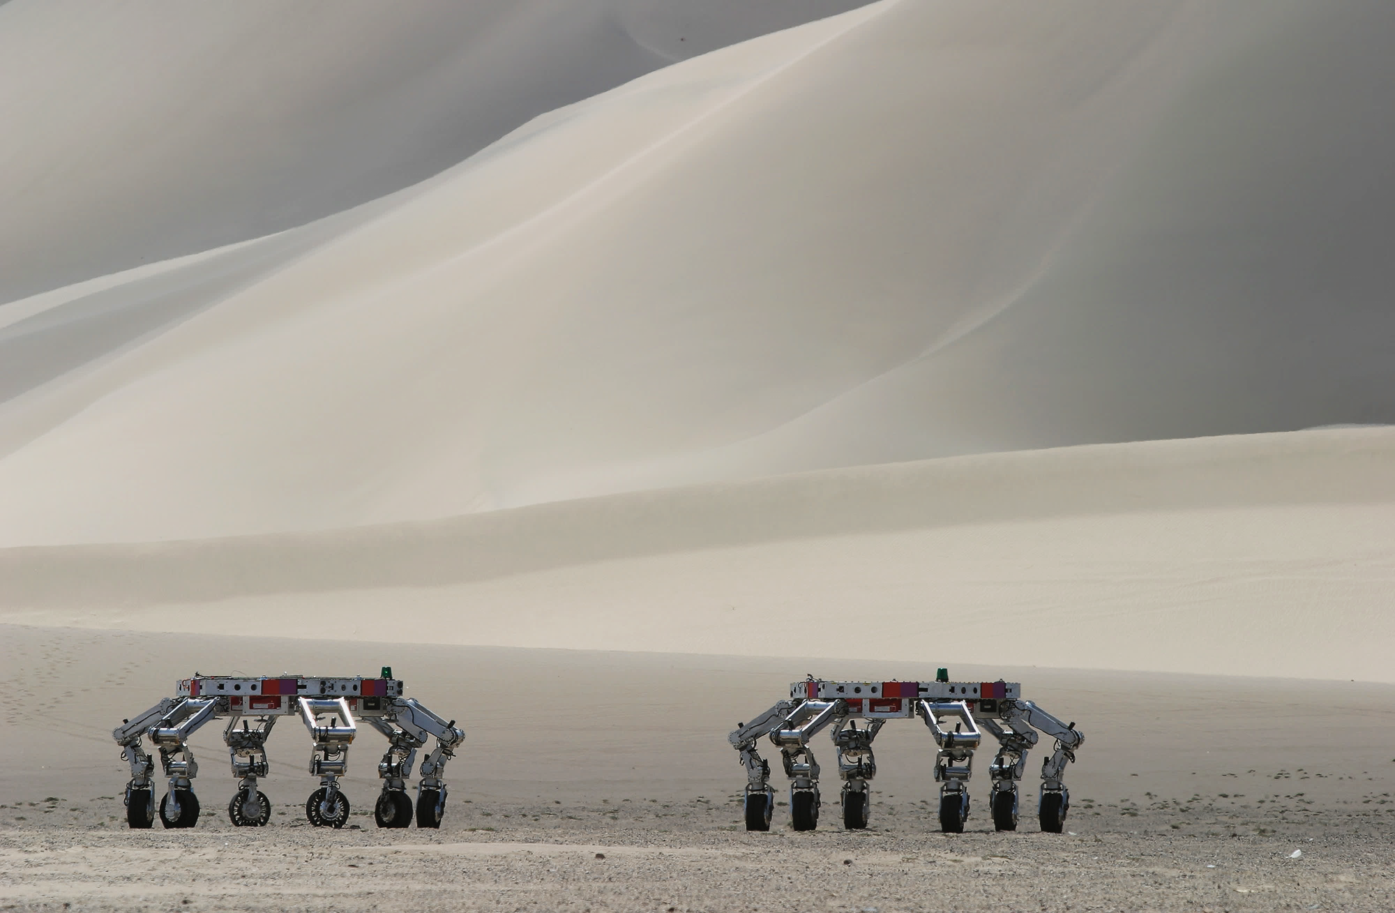

Athlete Lunar Rover
Project 2: 662 Robot Modelling
-Harshal Shirsath (119247419)
-Tarun Trilokesh (118450766)

Slide 2
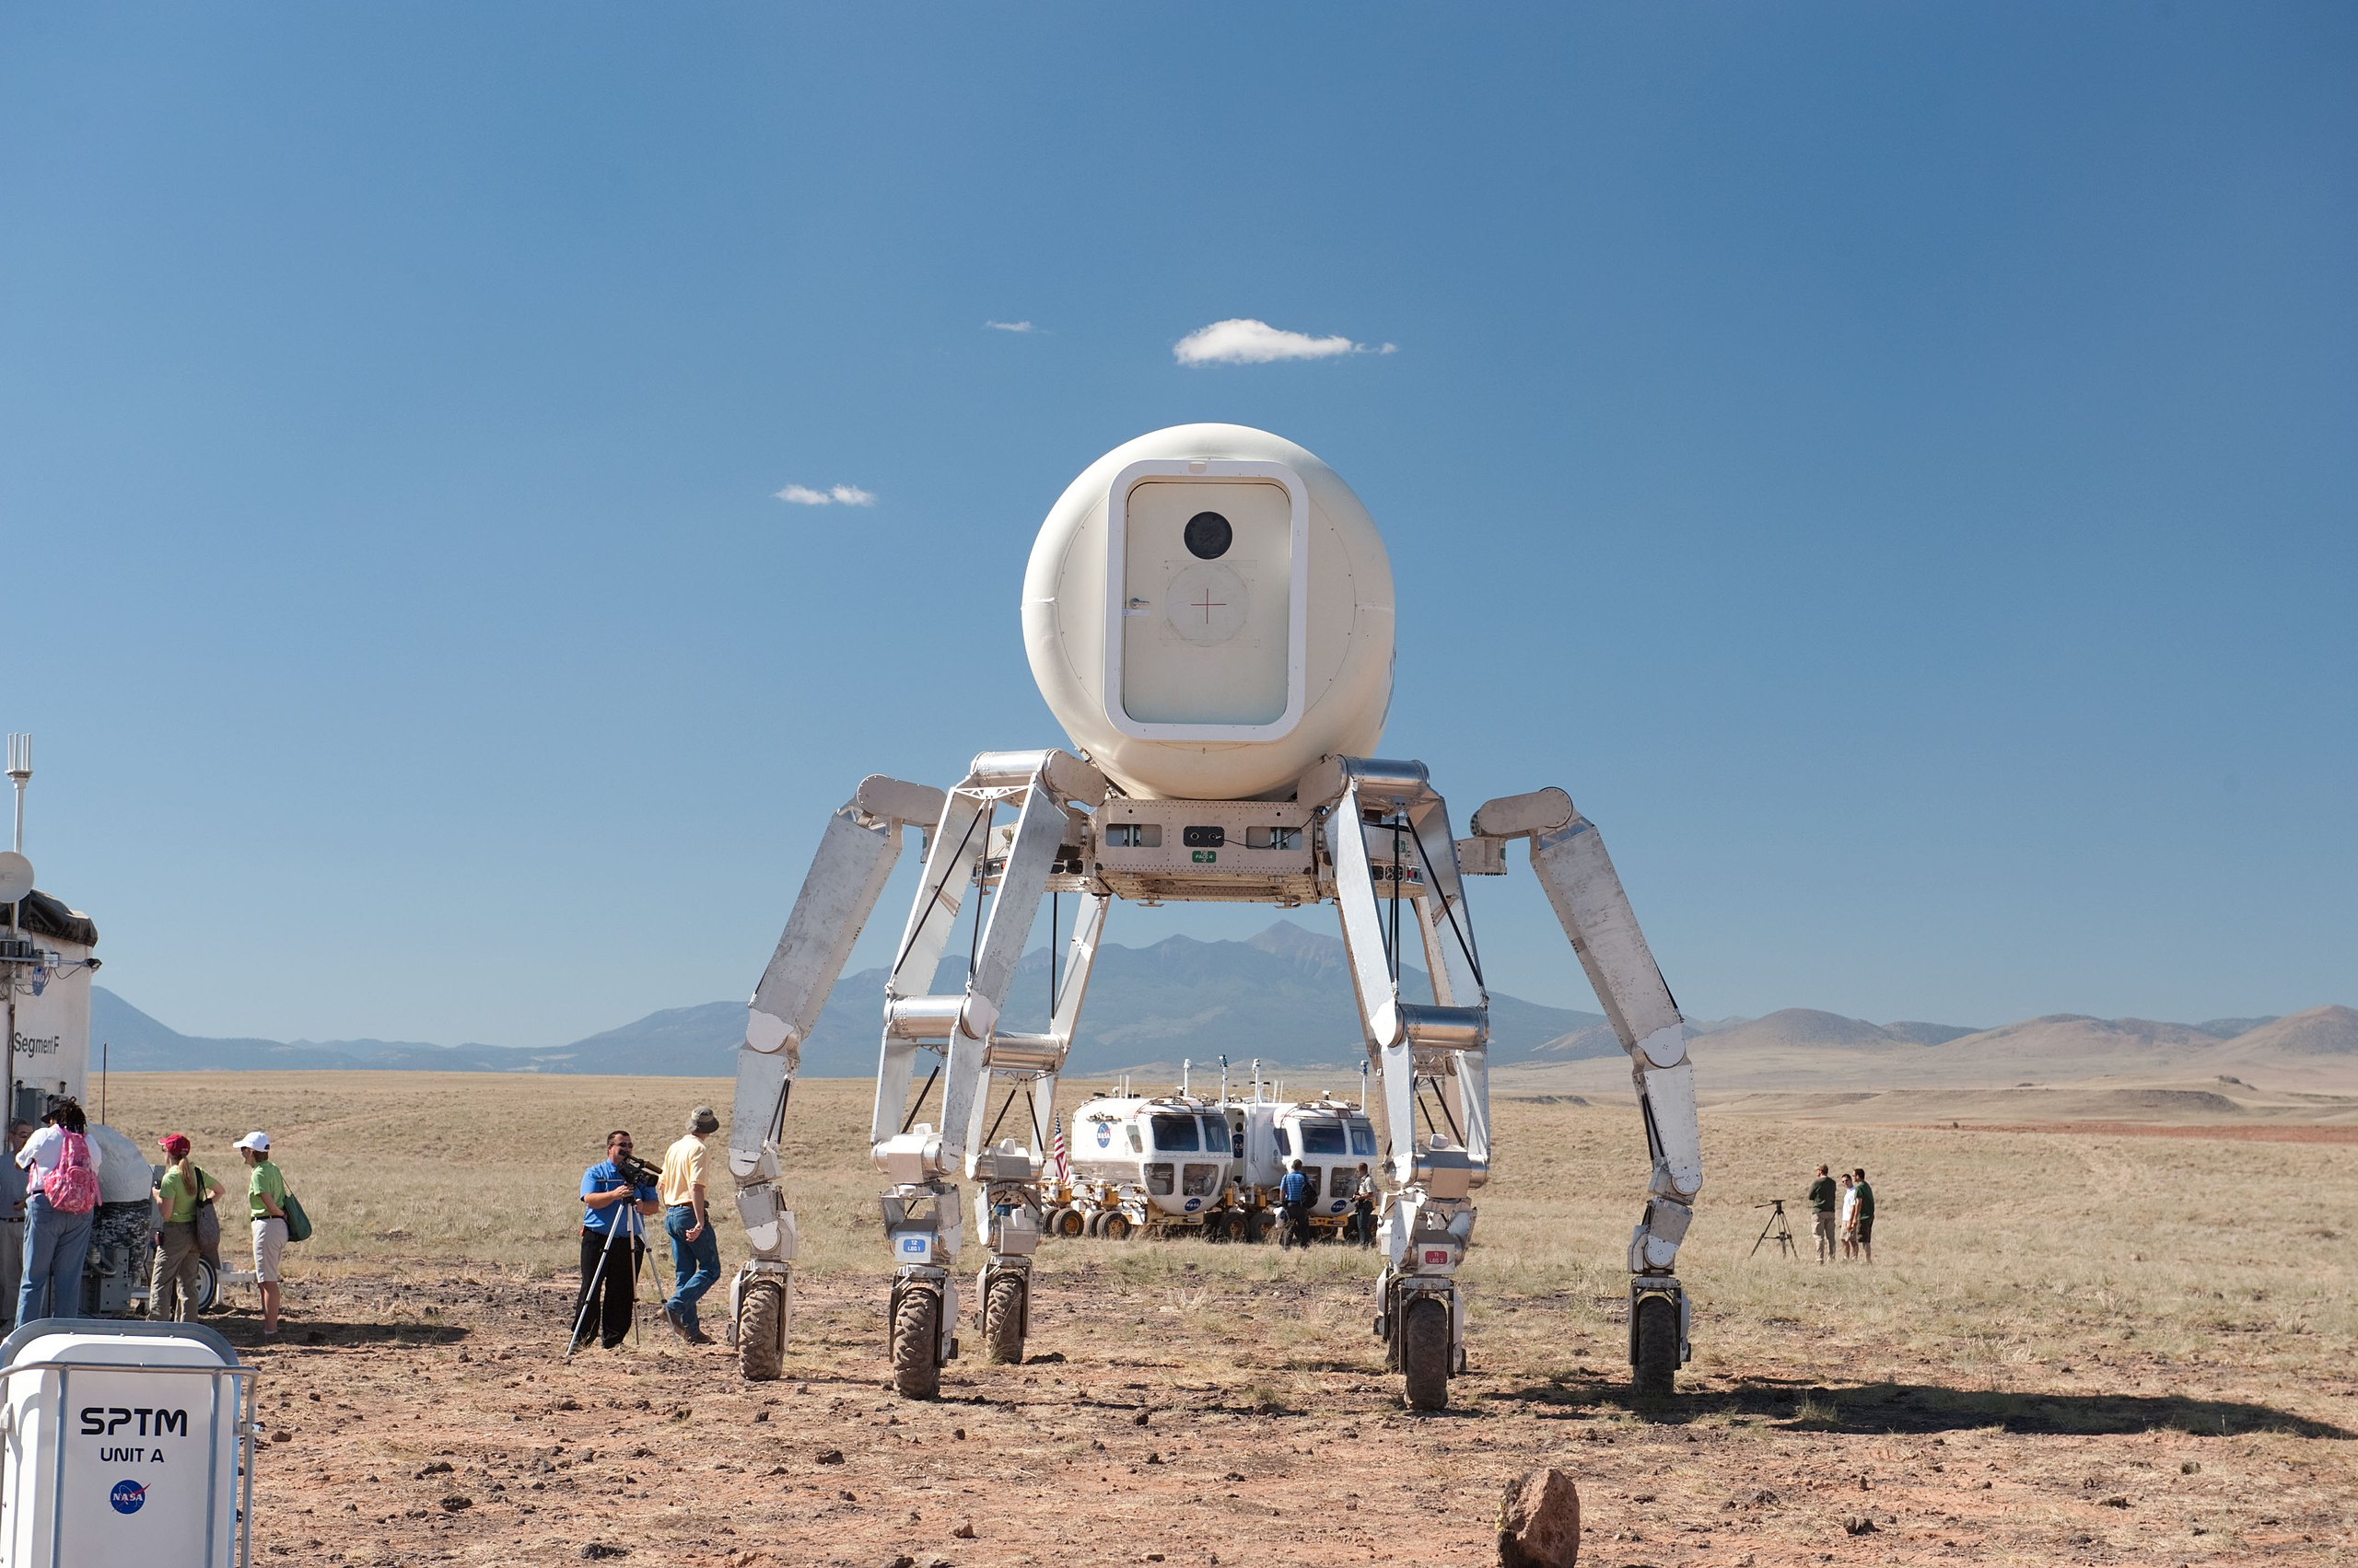
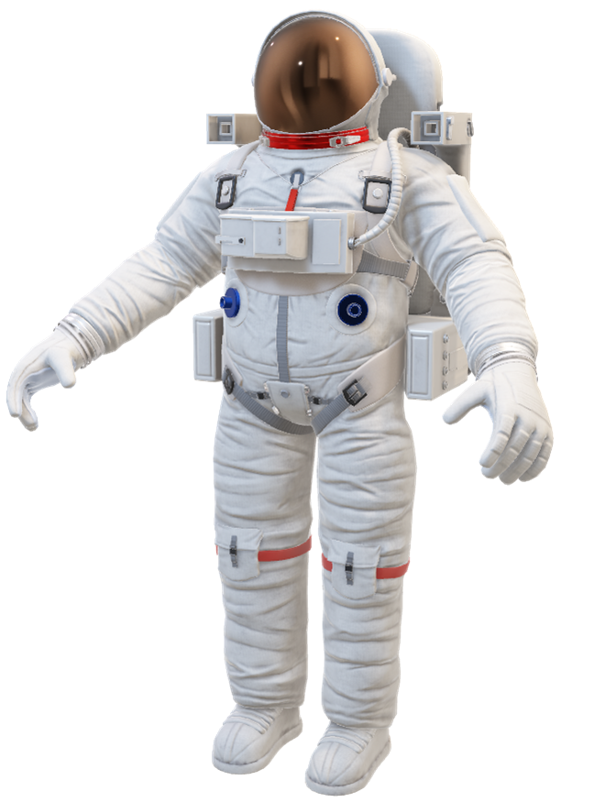
APPLICATION
Notes:
1.One of the most efficient rover and a prototype for Perseverance & Curosity (Mars rovers)
2. Multi Purpose System: The Athlete rover is a multi purpose system capable of docking or mating with special purpose devices including refueling stations, excavation equipments and different special end effector.
3. 6 DOF: It is a 6Dof manipulator leg for Wide Range Of Terrains.
4. Athlete has a capacity of 450kgs(990pounds) in Earth’s gravity with an added capability of docking multiple Athlete Vehicles together to support larger Loads

Slide 3
APPLICATION
Efficient Lunar Rover
Notes:
1.One of the most efficient rover after SPIRIT and OPPORTUNITY and is a prototype for PERSEVERANCE & CUROSITY.
2. Multi Purpose System: The Athlete rover is a multi purpose system capable of docking or mating with special purpose devices including refueling stations, excavation equipments and different special end effector.
3. 6 DOF: It is a 6Dof manipulator leg for Wide Range Of Terrains.
4. Athlete has a capacity of 450kgs(990pounds) in Earth’s gravity with an added capability of docking multiple Athlete Vehicles together to support larger Loads

Slide 4
APPLICATION
Efficient Lunar Rover
Multi-purpose system
Notes:
1.One of the most efficient rover and a prototype for Perseverance & Curosity
2. Multi Purpose System: The Athlete rover is a multi purpose system capable of docking or mating with special purpose devices including refueling stations, excavation equipments and different special end effector.
3. 6 DOF: It is a 6Dof manipulator leg for Wide Range Of Terrains.
4. Athlete has a capacity of 450kgs(990pounds) in Earth’s gravity with an added capability of docking multiple Athlete Vehicles together to support larger Loads

Slide 5
APPLICATION
Efficient Lunar Rover
Multi-purpose system
6Dof
Notes:
1.One of the most efficient rover and a prototype for Perseverance & Curosity
2. Multi Purpose System: The Athlete rover is a multi purpose system capable of docking or mating with special purpose devices including refueling stations, excavation equipments and different special end effector.
3. 6 DOF: It is a 6Dof manipulator leg for Wide Range Of Terrains.

Slide 6
APPLICATION
Efficient Lunar Rover
Multi-purpose system
6Dof
Larger payload capacity.
Notes:
1.One of the most efficient rover and a prototype for Perseverance & Curosity
2. Multi Purpose System: The Athlete rover is a multi purpose system capable of docking or mating with special purpose devices including refueling stations, excavation equipments and different special end effector.
3. 6 DOF: It is a 6Dof manipulator leg for Wide Range Of Terrains.

Slide 7
APPLICATION
Efficient Lunar Rover
Multi-purpose system
6Dof
Larger payload capacity.
Slope Climber
Notes:
1.One of the most efficient rover and a prototype for Perseverance & Curosity
2. Multi Purpose System: The Athlete rover is a multi purpose system capable of docking or mating with special purpose devices including refueling stations, excavation equipments and different special end effector.
3. 6 DOF: It is a 6Dof manipulator leg for Wide Range Of Terrains.
5. It is capable of climbing the slop gradient of 35 degrees in rough terrains whereas 25 degrees for softer terrains like dust deposits on the moon’s surface.

Slide 8
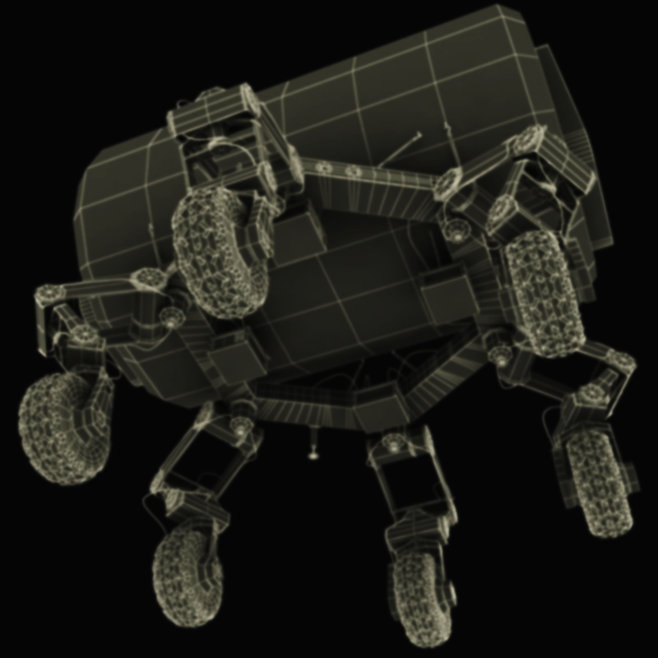
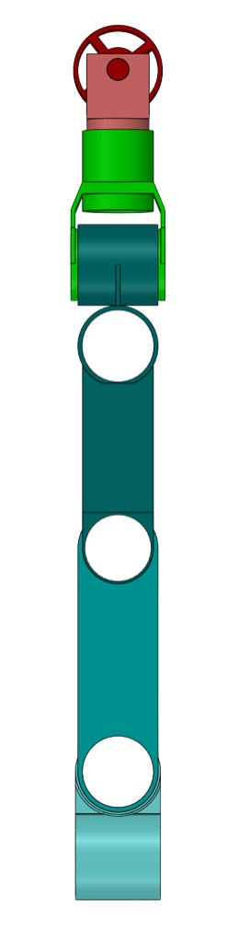
191mm
500mm
450mm
300mm
235mm
Coxa
Femur
Tibia
Roll
Pitch
Wheel

Slide 9
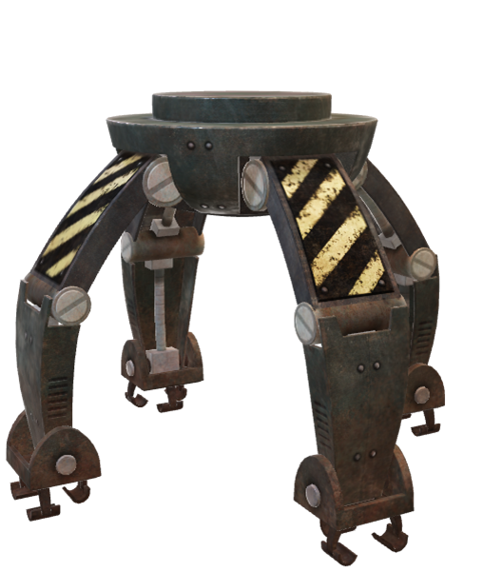
Z₅
Y₆
X₆
Link | θ | α | a | d
1 | θ₁ | 0 | 191mm | 0
2 | θ₂ | 90 | 500mm | 0
3 | θ₃ | 0 | 450mm | 0
4 | θ₄ | -90 | 300mm | 0
5 | θ₅ | -90 | 235mm | 0
6 | θ₆ | 90 | 0 | 0
Z₅
Y₅
X₅
Y₄
X₄
Z₄
X₃
Y₃
Z₃
X₂
Y₁
Z₂
Z₁
X₁
Y₁
Notes:
1.

Slide 10
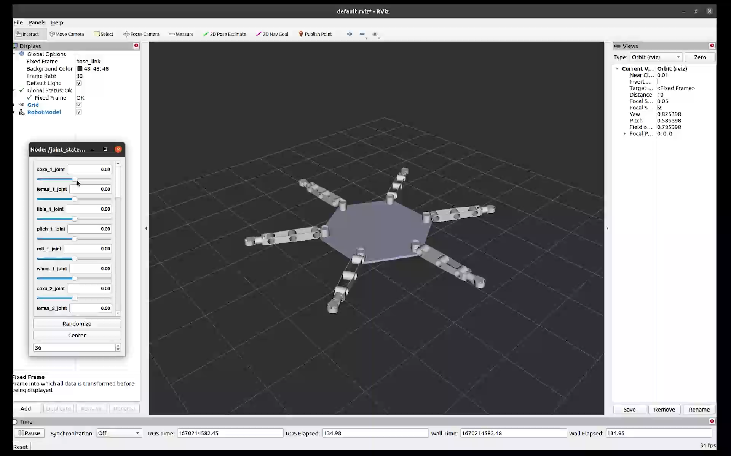
Notes:
The robot is visualized in Rviz.
We can see the joint rotations for every leg and respective links

Slide 11
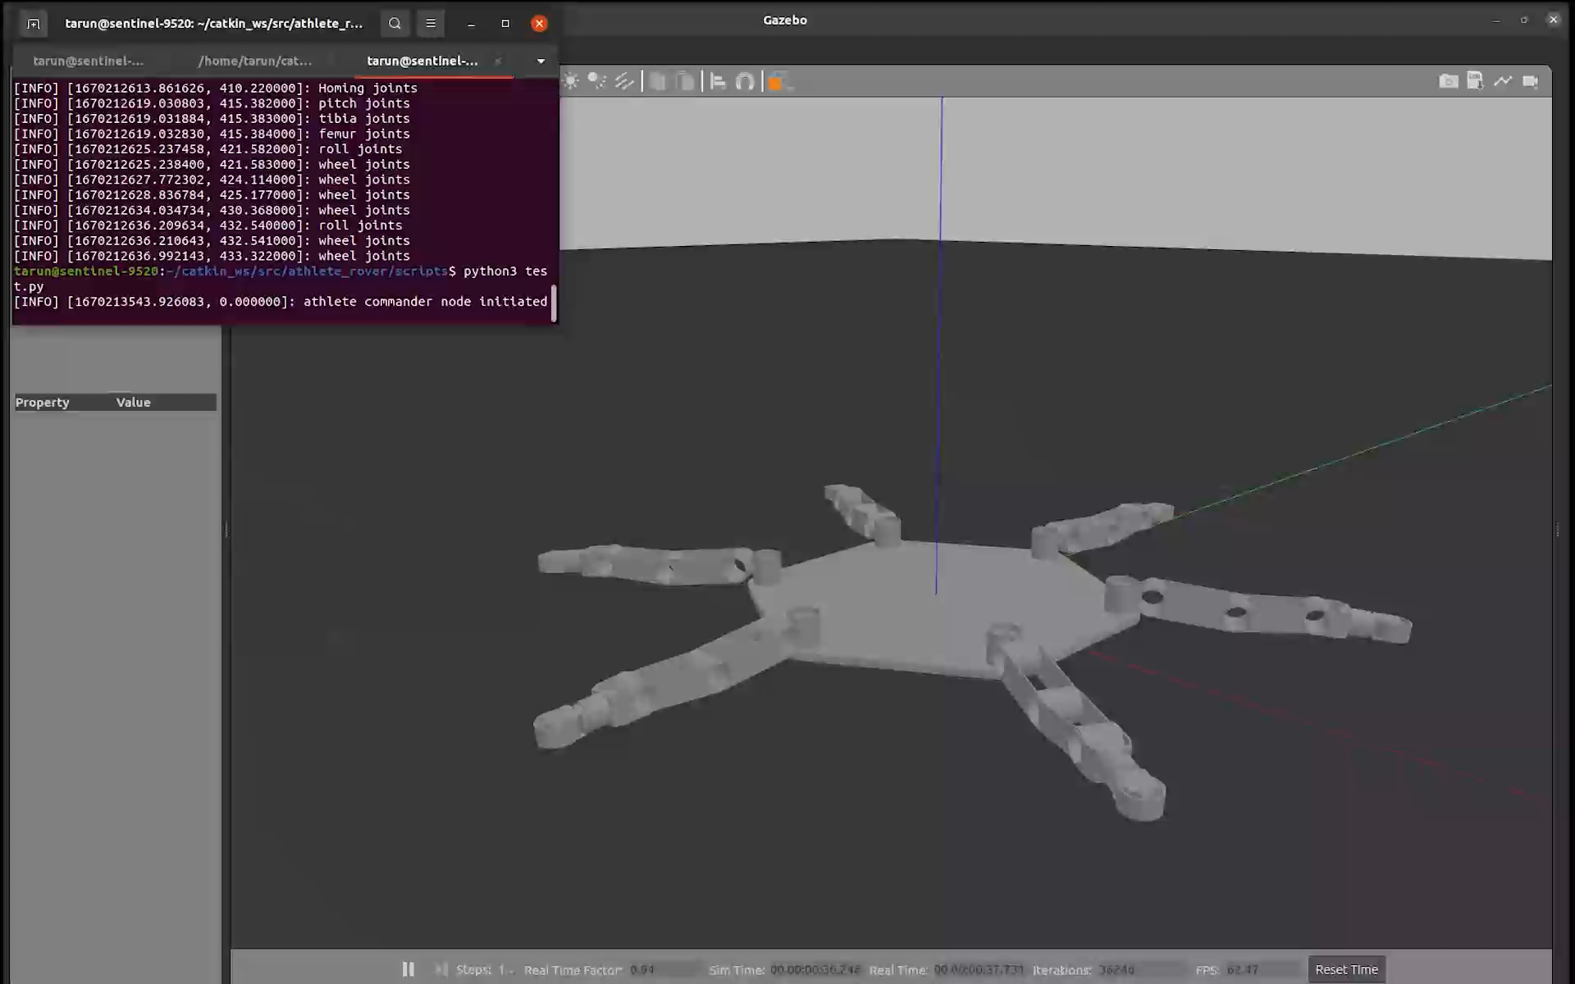
Notes:
Here is the small clip of robot performing some of the tasks
First it is homing the joints making sure the joints are in right positions
Next it is in more compact position for storage and transportation
Since there is a rolling joint near the wheels which helps it to steer when the robot is driven through wheels on a planar surface.

Slide 12
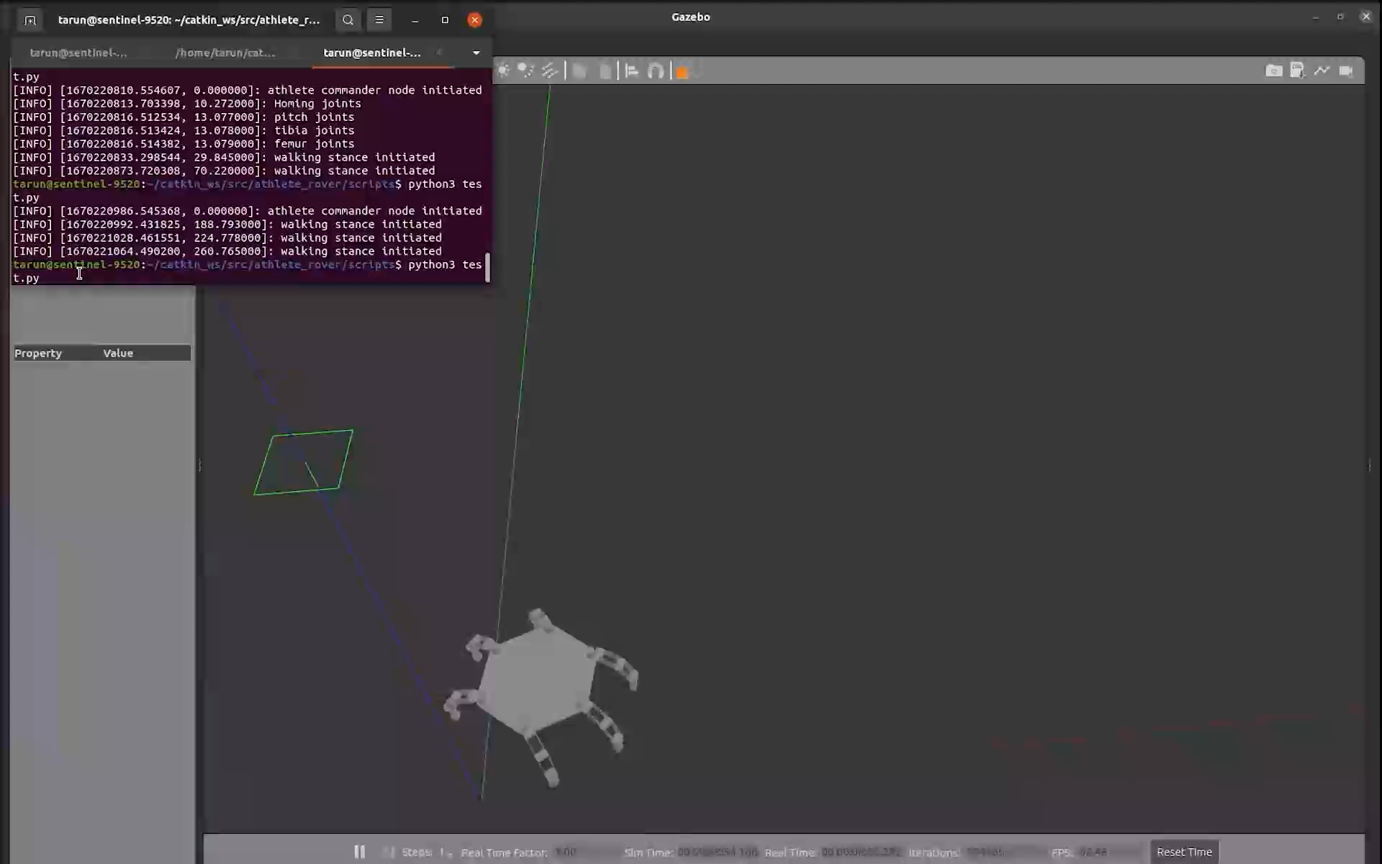
Notes:
In this video it is walking with all the six legs using the GAIT system.
The robot is approximately walking at a speed of 30m/s
This video is speedup by 4X.

Slide 13
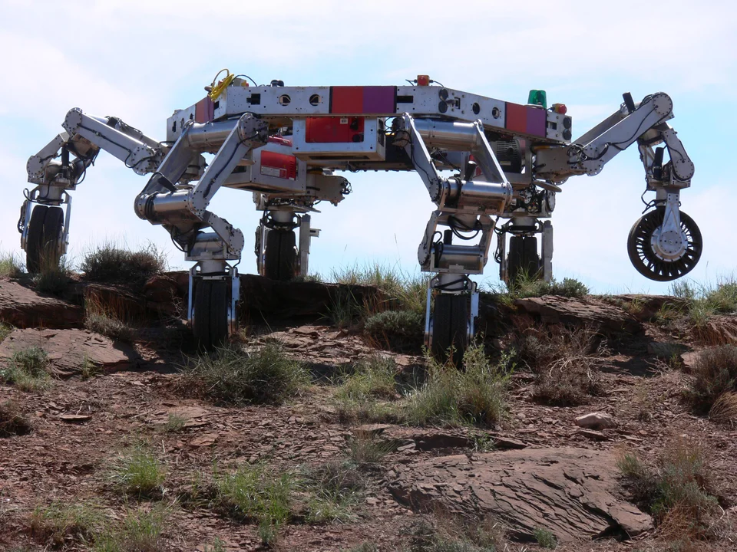
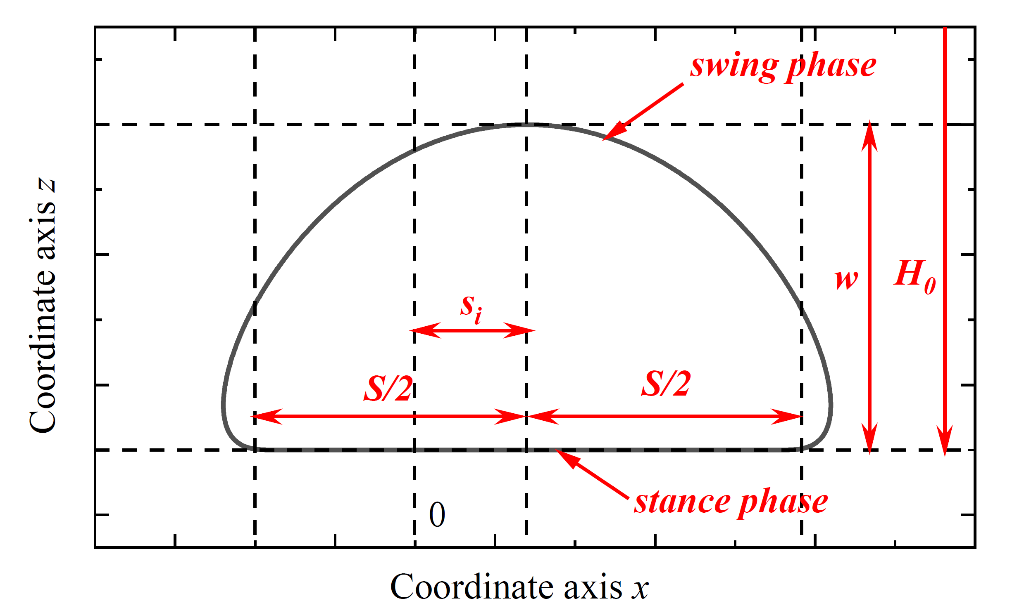
PROBLEMS FACED
URDF file export: The body after export did not maintain the set positions.
Gazebo Spawning: Forces were not sufficient enough to lift the body. The PID tuning was necessary to get the desired joint forces, to maintain the joint angles.
Controllers: Assigning controllers to all the 36 joints and controlling the joints with complete coordination.
Designing gait system for a hexpod robot.(Left side of the slide).

Slide 14
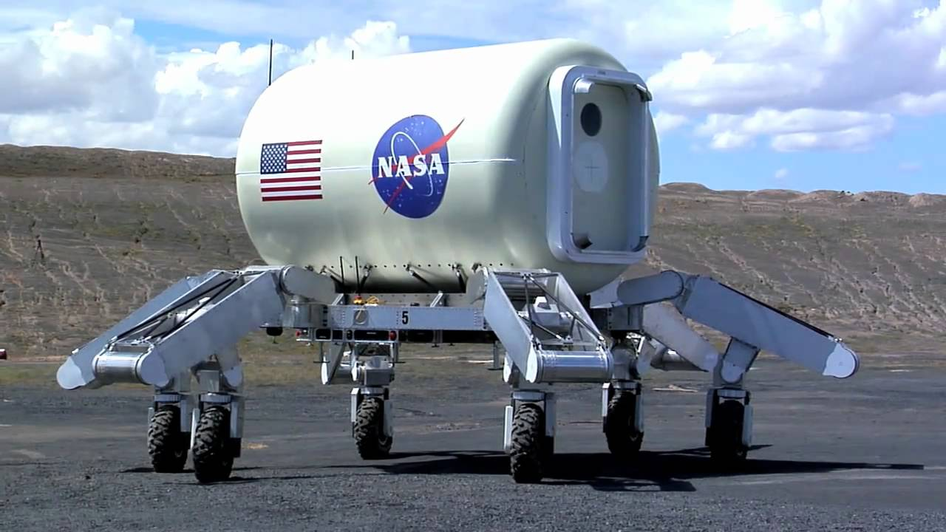
Lesson Learned
URDF file manipulation
Inverse &Forward Kinematics of hexapod robot.
Importance of joint damping and friction
PID tuning of joints
Notes:
We have seen that even after creating the URDF file from Solidworks we see some joints in some undesired position.
Homing of these joints is very necessary to define the limiting angles
We saw that joints to hold the position needed to implemented in the URDF file.
The forces required to lift the body of 250 kgs in Gazebo world.

Slide 15
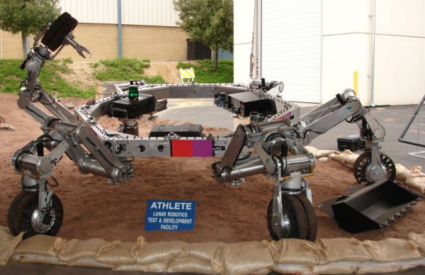
FUTURE SCOPE
Adding additional manipulators to the wheel for on ground operations.
Enabling the robot to sense the environment using Cameras and Lidar
Adding IMU to the robot for better stability.
Application of multi agent systems.

